Slide 1


Software Design & System Design
DDD
Otávio Santana, Founder
otavio@os.expert

Slide 2
Introduction
Topics on this class
Bounded Context
Context Mapping
Ubiquitous Language
Patterns of integrations
Patterns
Overview
Entity
Aggregator
Repository
Coupling/Decoupling
Refactoring

Slide 3
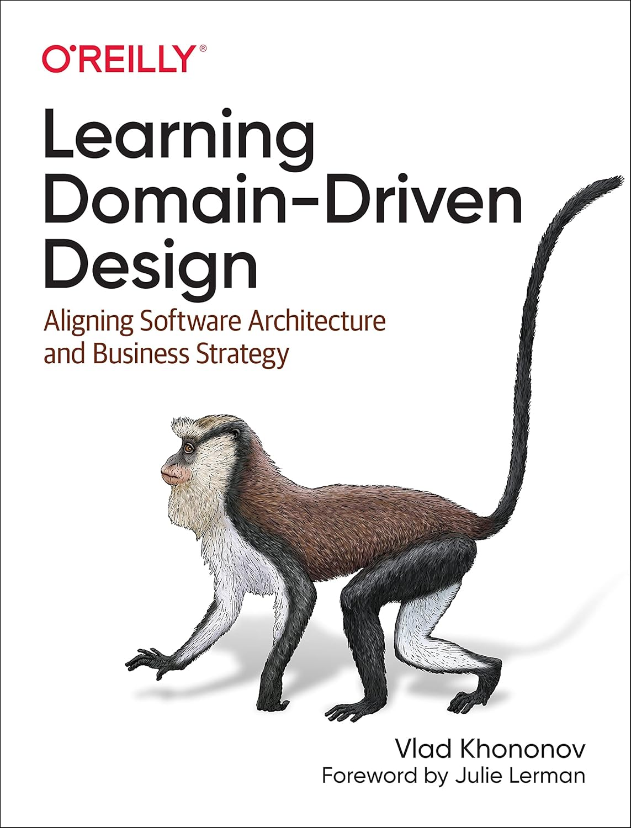
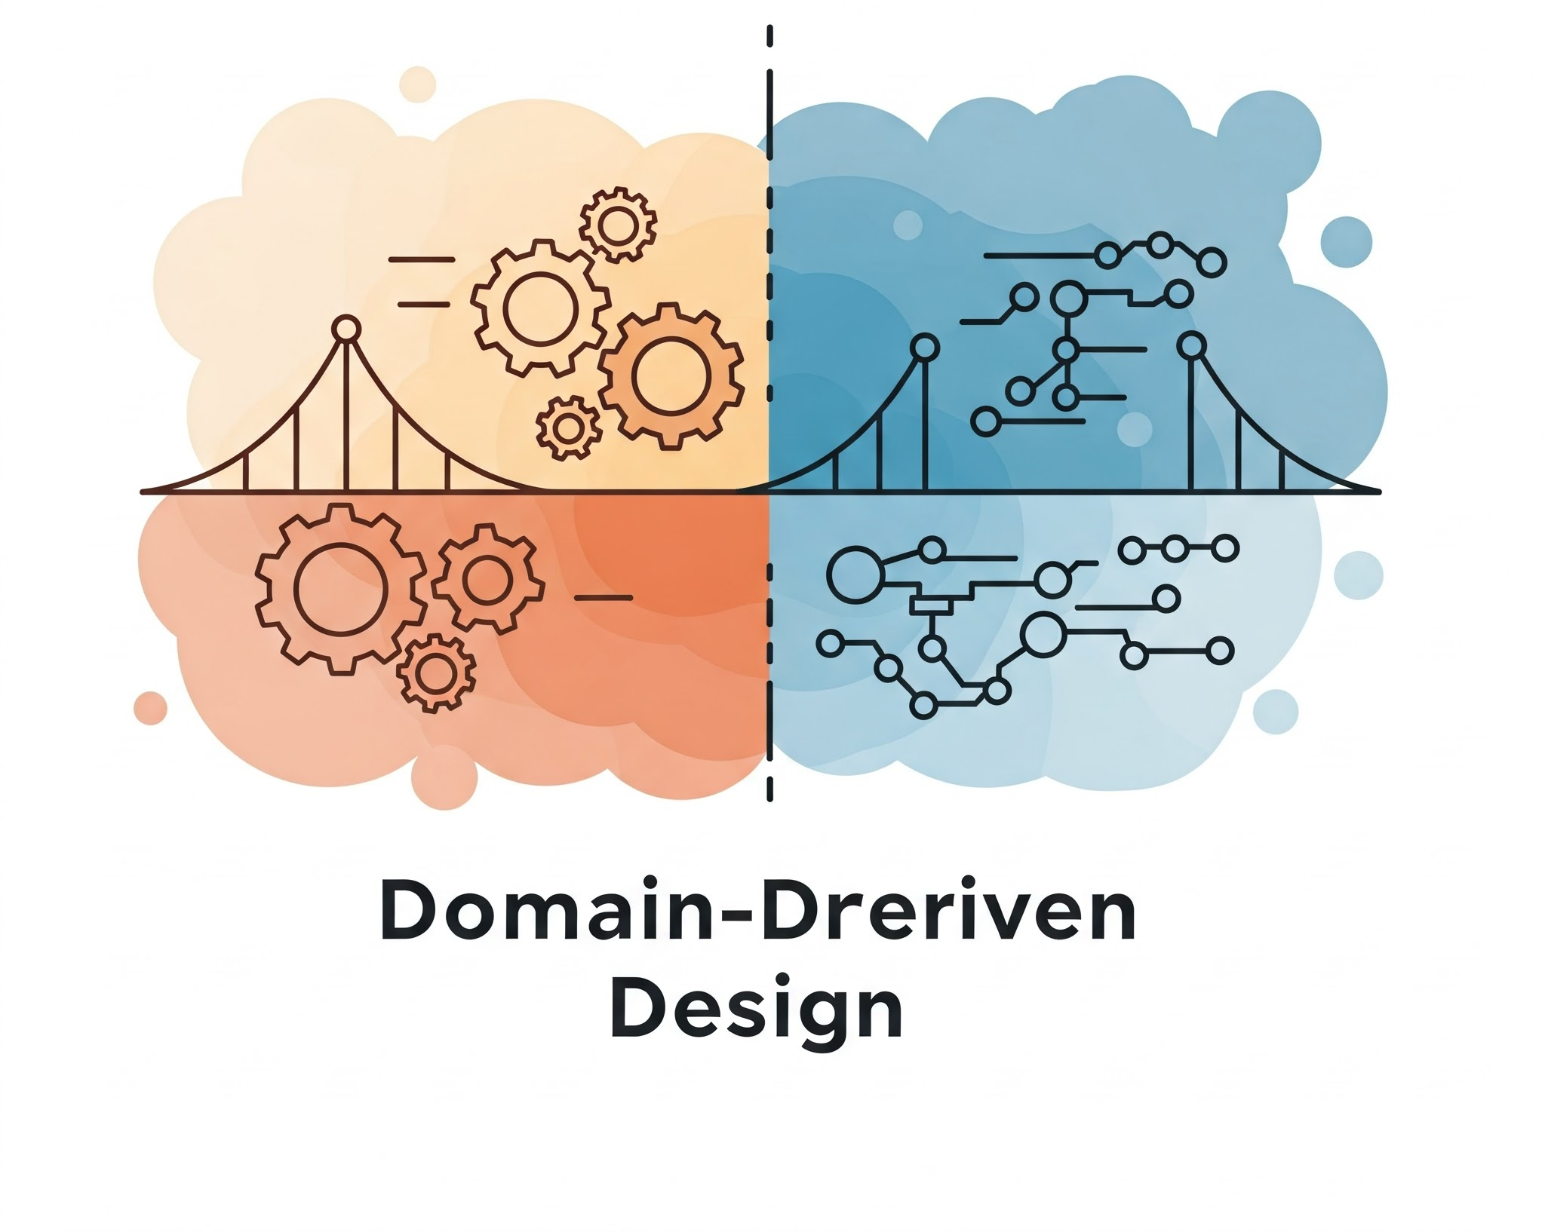
Domain Driven Design
Designing software to meet business goals with less rework

Slide 4
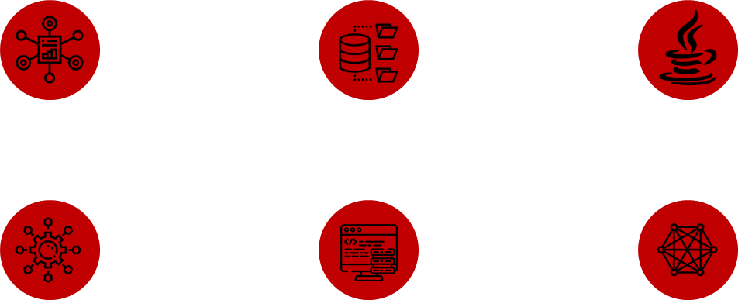
DDD?
The biggest misunderstanding in the software industry!
It is a framework!
Repository, Entity
Java
Microservices
Code only
Complex
Notes:
https://www.quora.com/What-is-the-etymology-of-the-title-Staff-Engineer

Slide 5
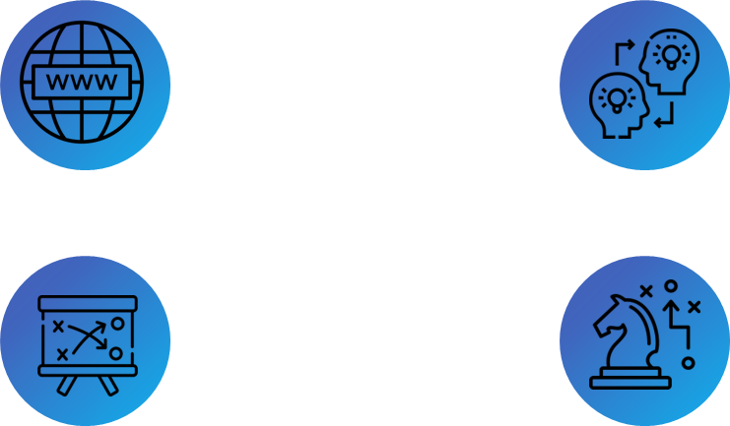
DDD!
Handling and focus to the Business
Domains
Transfer Knowledge
Tactics
Strategy
Notes:
https://www.quora.com/What-is-the-etymology-of-the-title-Staff-Engineer

Slide 6
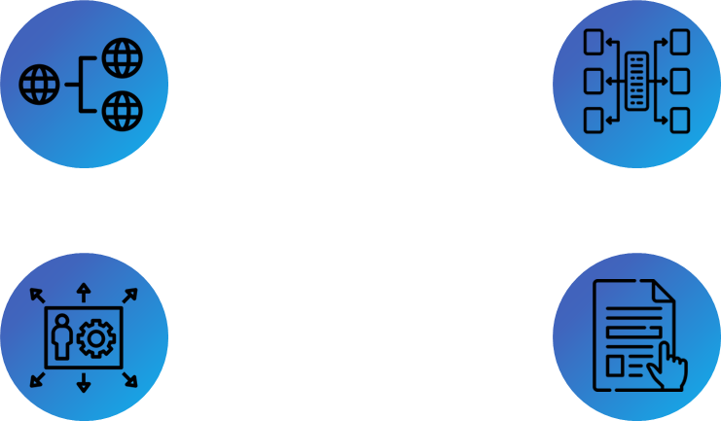
Strategic DDD
The biggest mistake when implementing DDD
Domains and Subdomains
Context Mapping
Ubiquitous language
Bounded Contexts
Notes:
https://www.quora.com/What-is-the-etymology-of-the-title-Staff-Engineer

Slide 7
Domains
Central area of a company’s operations
Subdomain Type | Role | Business Differentiation | Complexity of Business Logic
Core Subdomain | Unique to the company, defining its identity and competitive advantage | High | High
Generic Subdomain | Common across all companies, standard business activities | Low | High
Supporting Subdomain | Supports core business activities without providing direct competitive advantage | Medium | Varies
Notes:
https://www.quora.com/What-is-the-etymology-of-the-title-Staff-Engineer

Slide 8
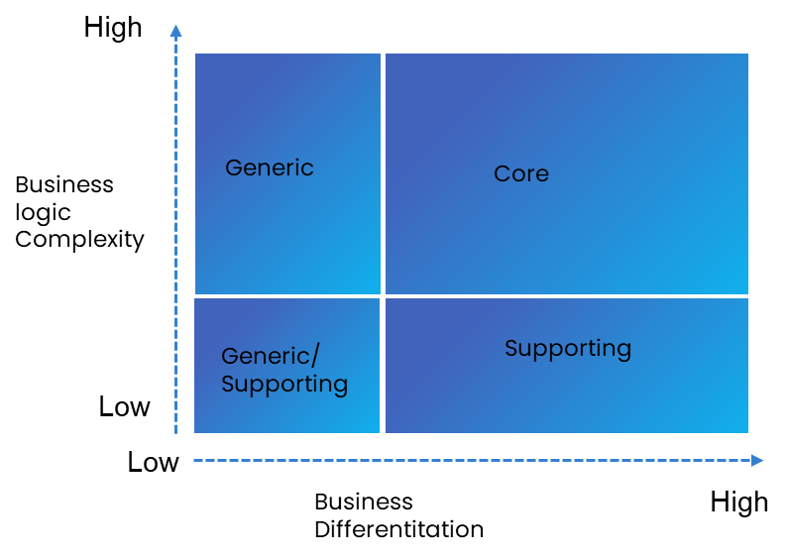
Domains
The subdomains types
Notes:
https://www.quora.com/What-is-the-etymology-of-the-title-Staff-Engineer

Slide 9
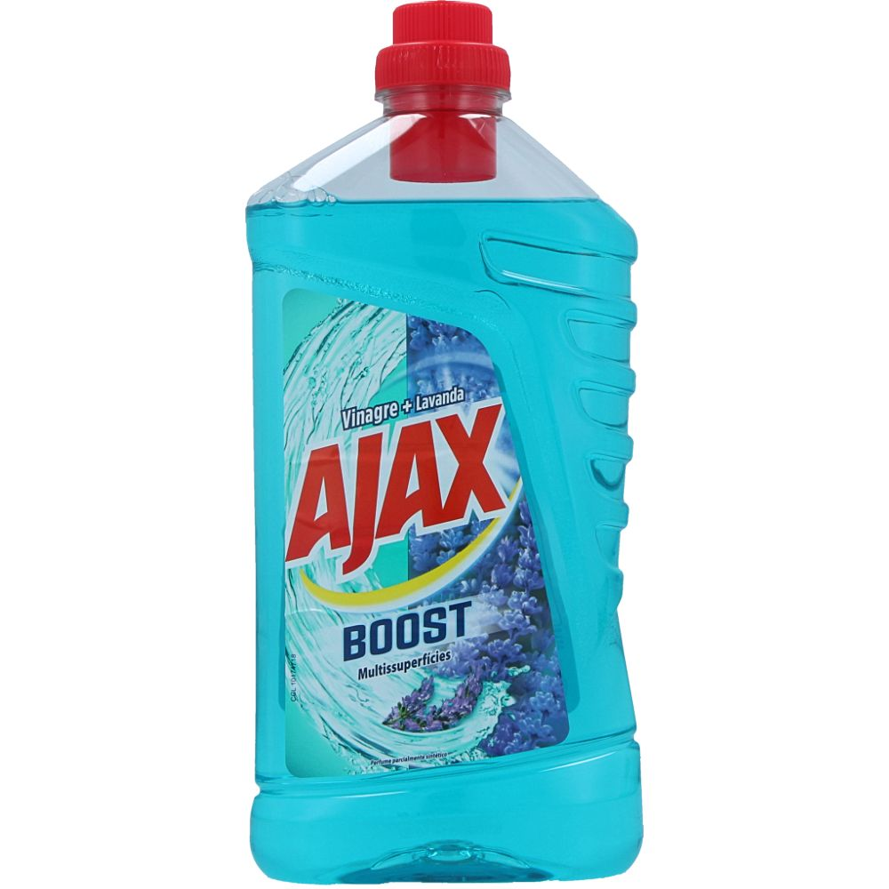
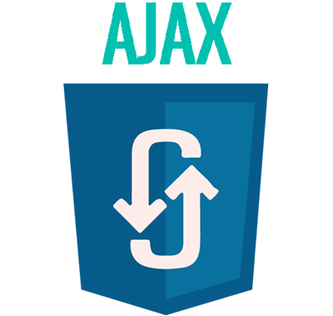

Ubiquitous Language
The core's communication
Define common terminology
The common language between experts and the engineering team.
The same word can vary from context
Notes:
https://www.quora.com/What-is-the-etymology-of-the-title-Staff-Engineer

Slide 10
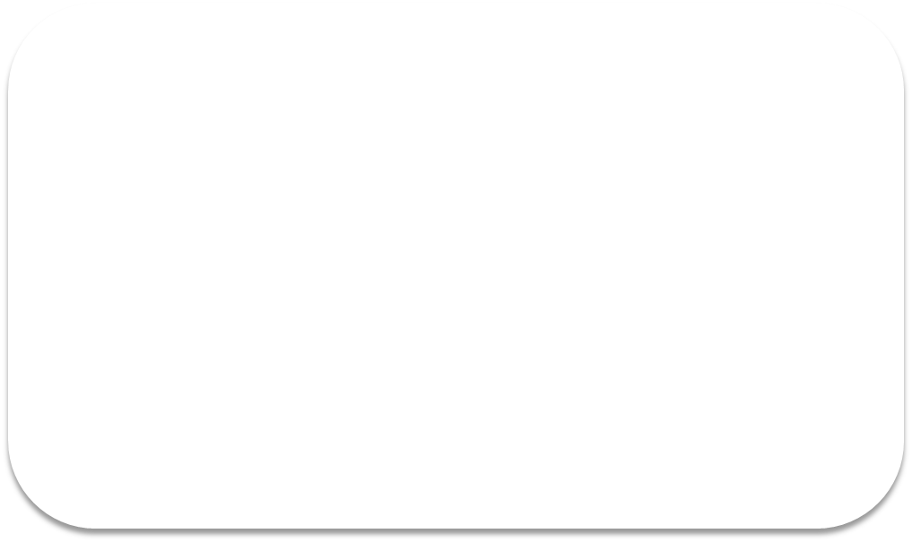
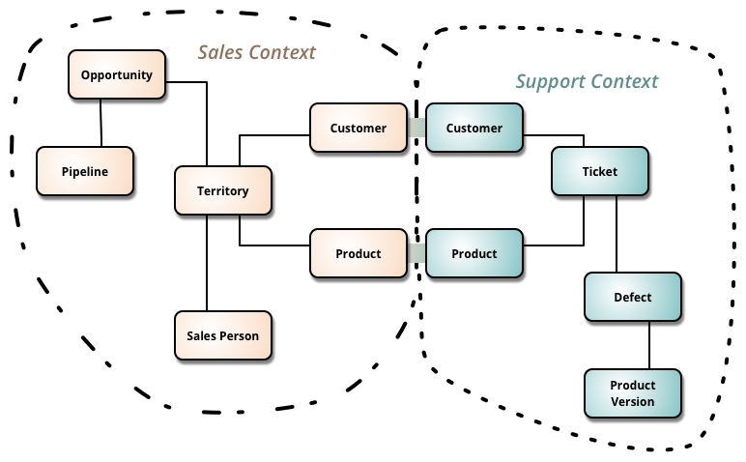
Bounded Contexts
Subset of the ubiquitous language
Notes:
https://www.quora.com/What-is-the-etymology-of-the-title-Staff-Engineer

Slide 11
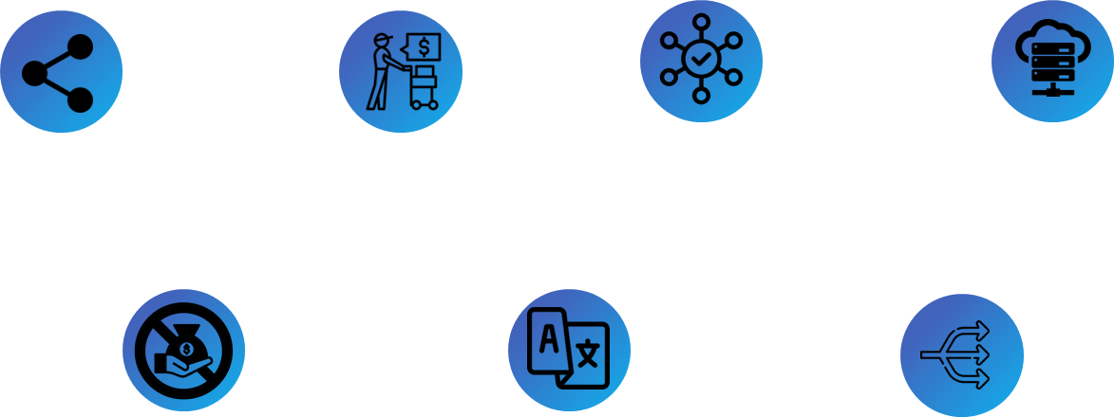
Context Mapping
The relationships between these contexts
Shared Kernel
Customer-Supplier
Conformist
Open Host Service
Anticorruption Layer
Published Language
Separate Ways
Notes:
https://www.quora.com/What-is-the-etymology-of-the-title-Staff-Engineer

Slide 12
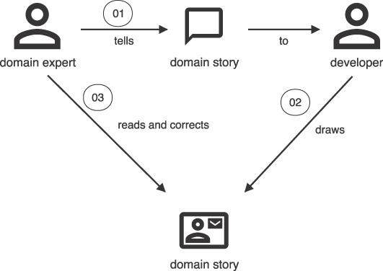
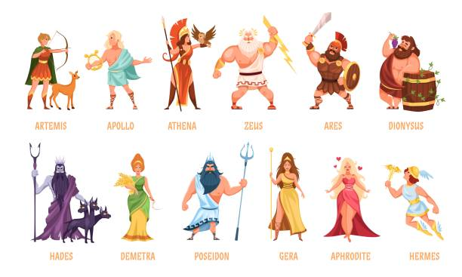
Domain Storytelling
A Collaborative, and Visual Way to Build DDD
Notes:
https://www.quora.com/What-is-the-etymology-of-the-title-Staff-Engineer

Slide 13




Tactic DDD
The second step
Entity
Service
Repository
Aggregates
Value Object
Factories
Events
Notes:
https://www.quora.com/What-is-the-etymology-of-the-title-Staff-Engineer

Slide 14
Strategic and Tactical
Focus on tactics is the start of a huge mistake
Strategic
Get something done
Working code isn't enough
Tactical tornado
Total progress
Tactical
Time

Slide 15
Using Annotations
Getting architecture evidences
@Entity
public class CreditCard {
@Identity
private BigInteger id;
private String number;
private String name;
private YearMonth expiry;
}

Slide 16
Governance
Automating processes and good practice rules
@AnalyzeClasses(packages = "expert.os.examples")
public class IntegrationSampleTest {
@ArchTest
private ArchRule dddRules = JMoleculesDddRules.all();
@ArchTest
private ArchRule layering = JMoleculesArchitectureRules.ensureLayering();
}

Slide 17
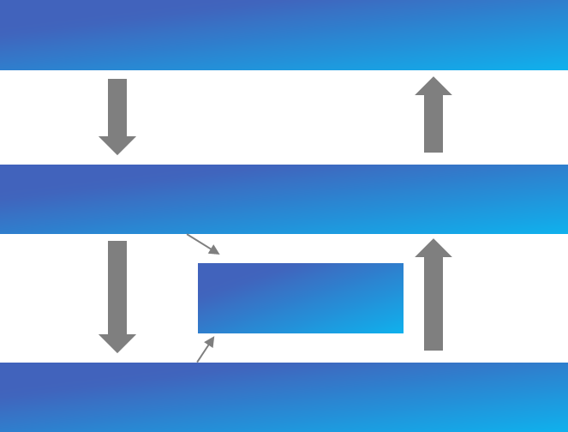
Architecture DDD
Using Layers to abstraction
Presentation Layer
Application Layer
Domain Layer
Infrastructure Layer
Notes:
https://www.quora.com/What-is-the-etymology-of-the-title-Staff-Engineer

Slide 18
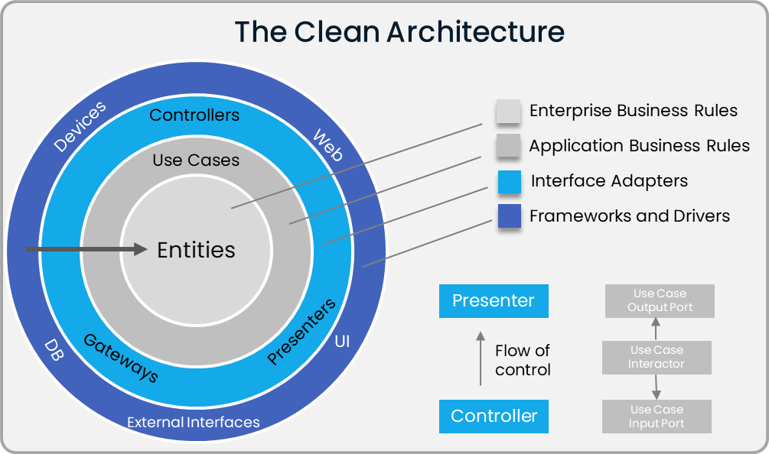
Clean Architecture
How to Combine it with DDD?
Notes:
https://xmolecules.org/aea-paper.pdf

Slide 19
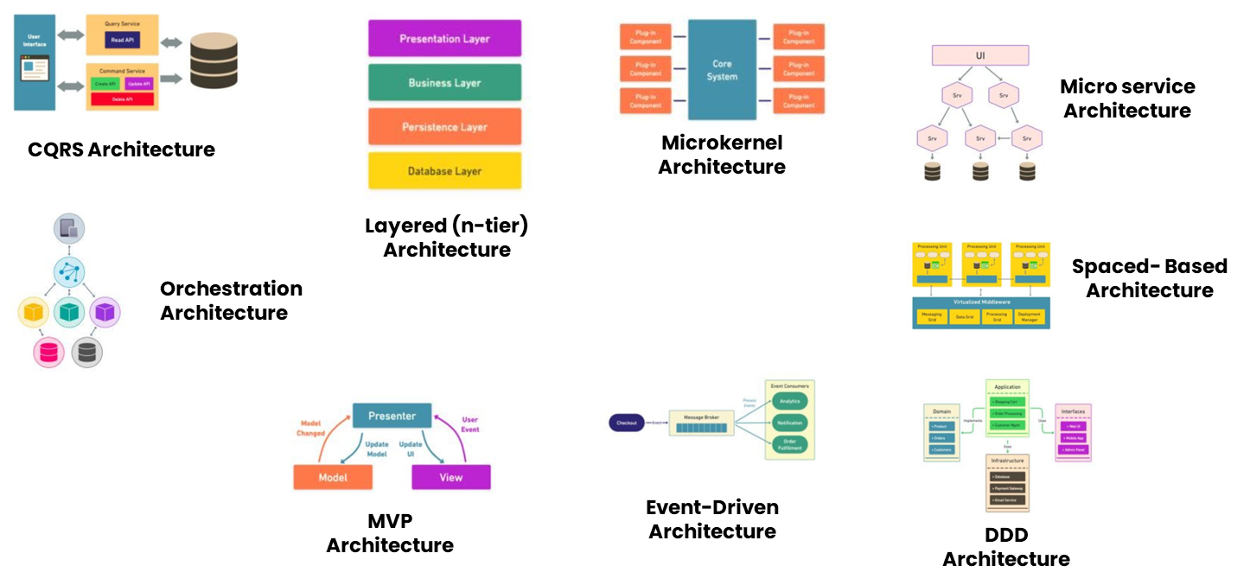

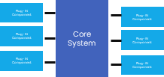
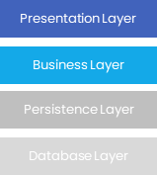
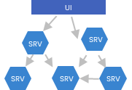
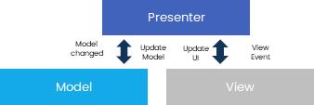

The Architecture styles
There is a world beyond microservices and Hexagon model
Notes:
https://xmolecules.org/aea-paper.pdf

Slide 20
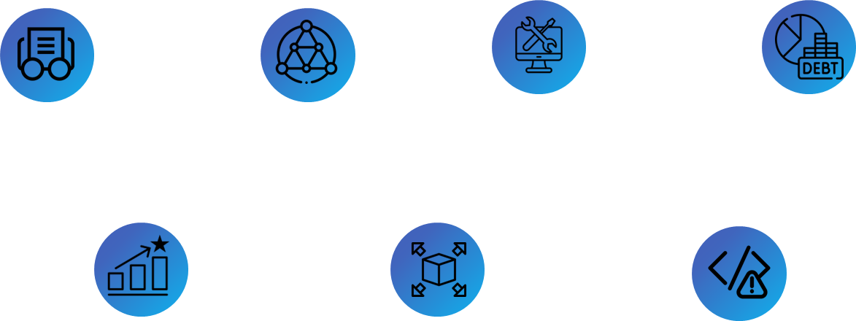
Refactoring
Be ready for change
Better Readability
Reduced Complexity
Improved Maintainability
Reduced Technical Debt
Enhance Performance
Effortless Extensibility
Fight against Software Erosion
Notes:
https://xmolecules.org/aea-paper.pdf

Slide 21
Refactoring
Be ready for change
Better Readability
Reduced Complexity
Improved Maintainability
Reduced Technical Debt
Enhance Performance
Effortless Extensibility
Fight against Software Erosion
Notes:
https://xmolecules.org/aea-paper.pdf

